Slide 1
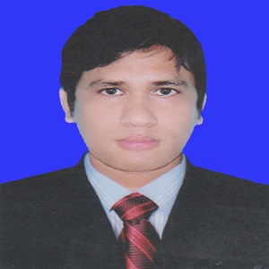
Wellcome
Abdullah Al Noman
Trainee ID: 1241478
Batch ESAD-J2EE/TCLD-A/36/01
Email: nomanidb36@gmail.com

Slide 2
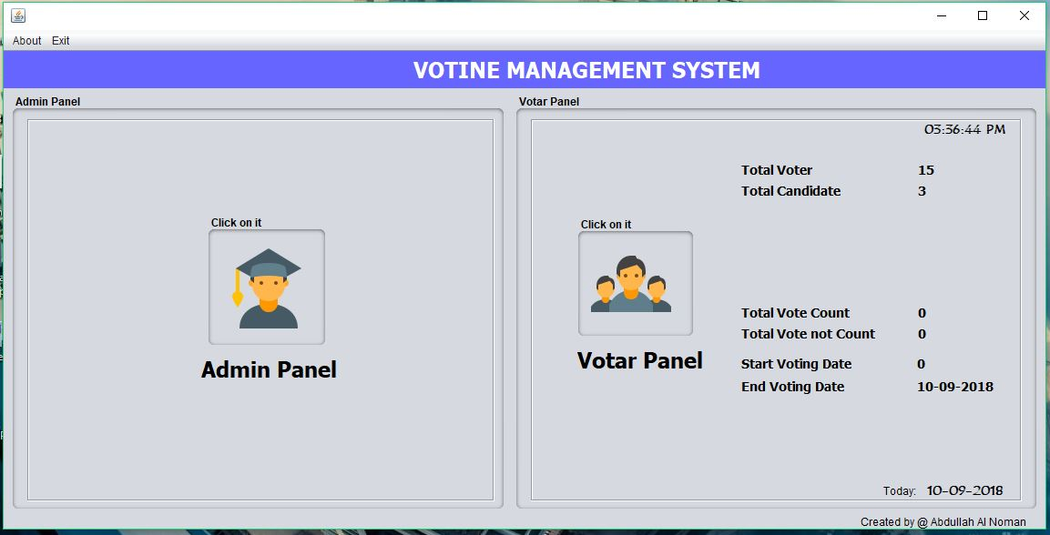
This is the First page of the ONLINE VOTING SYSTEM. When you open the Software the at the first time you see it.

Slide 3
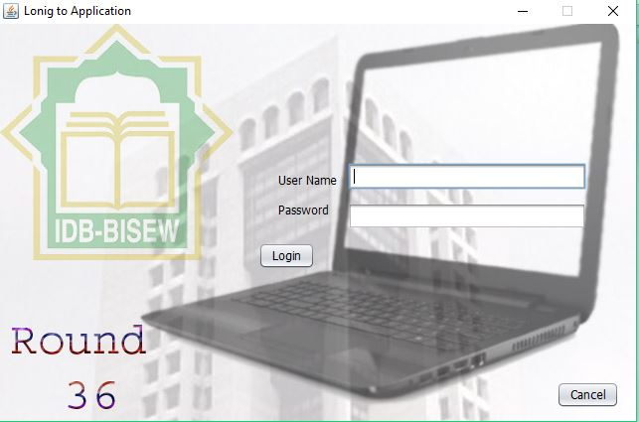
If you Click on the Admin Panel then display the Logion page of controlling the Management.

Slide 4
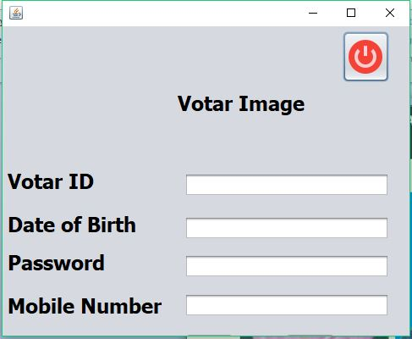
If you click on the Voter panel then at first you will fill up the condition of those fill. If those fill are match in the database then you will be permit at the Ballot page.

Slide 5
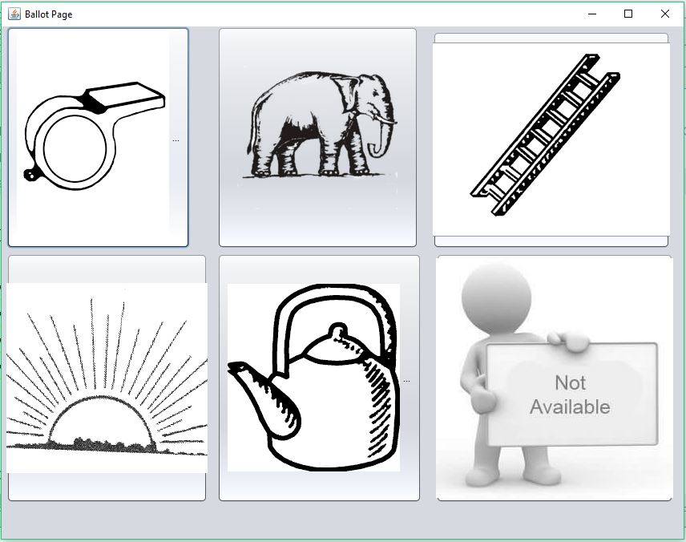
If the Ballot page opened then you can vote on your Chose. Only once and one from the others

Slide 6
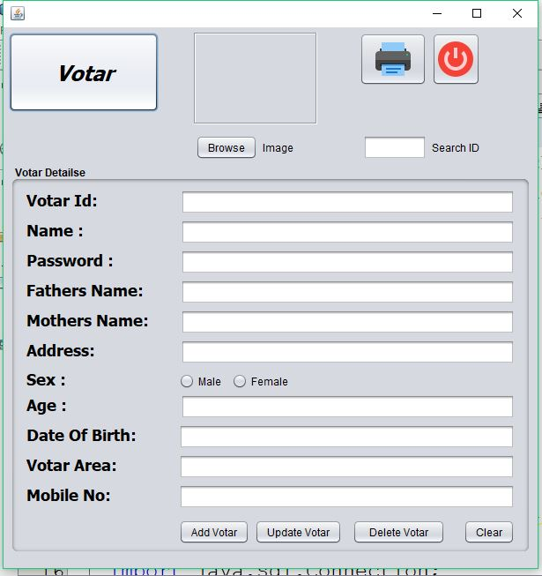
If you are admin then you can create a voter in Votar Panel you can fill up the condition of the all components. Then click all Add Votar button. You can edit of delete voter from here.

Slide 7
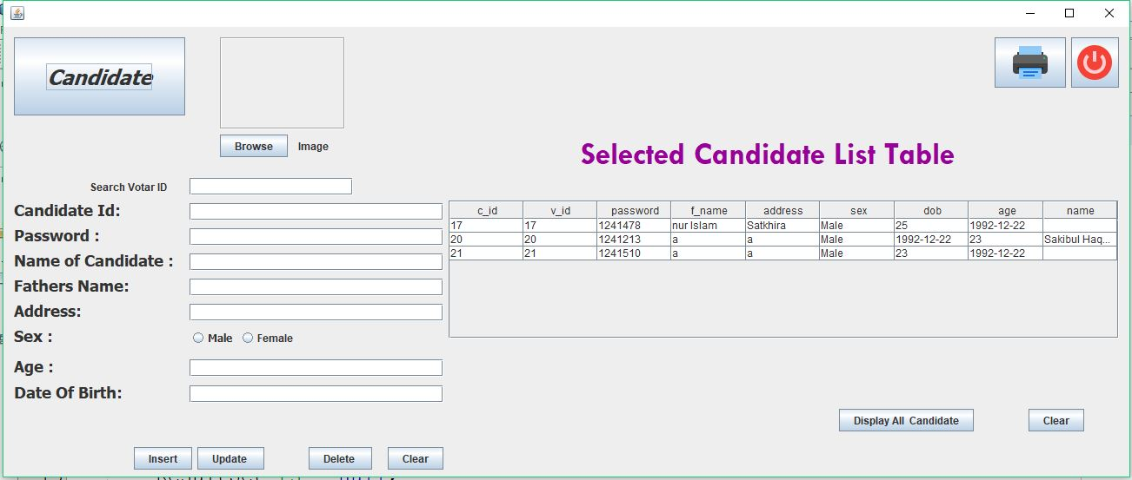
If you voter then you can get the nomination as a candidate from here the Candidate panel you can edit of select the candidate from here.

Slide 8
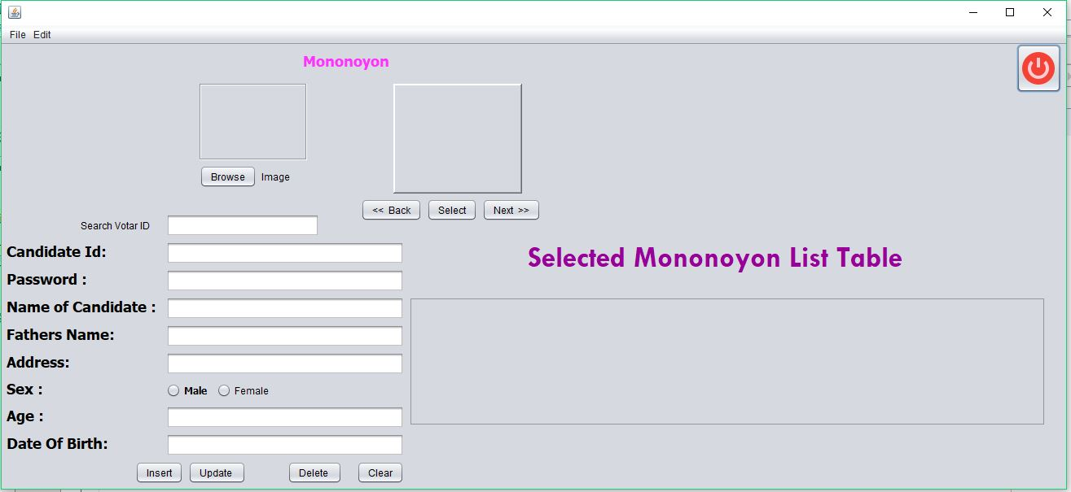
You can get finally selected by this panel.you can get the Ballot and ready for preparation for voting.

Slide 9
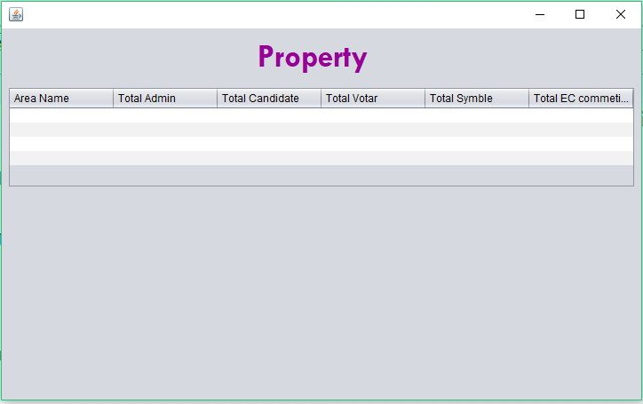
You can see the total administrative, admin, candidate, vorer, Ballot and Election Commotion

Slide 10
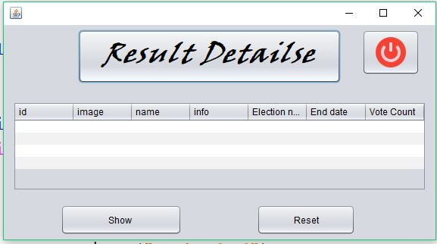
You can check the details of the result, if you want then you can hide it on click the rest button

Slide 11
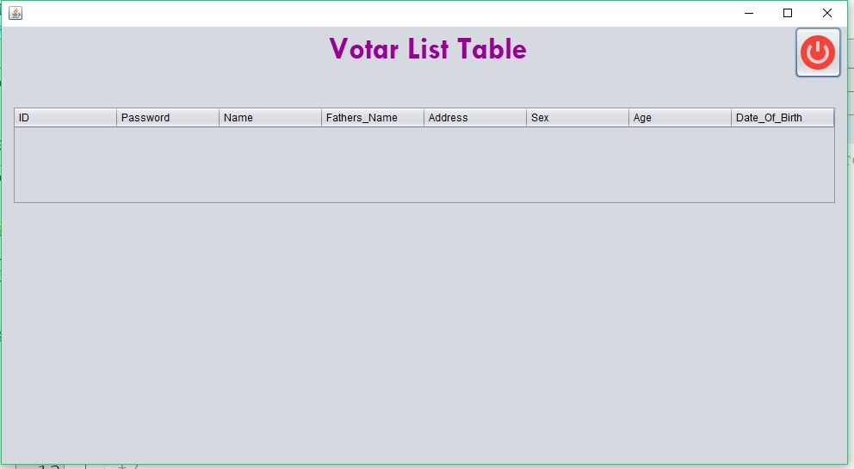
You can see the total voter list from this panel. It just showing the voter list and you can print it.

Slide 12
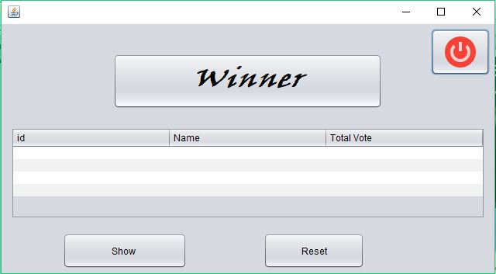
You can see the panel the winner person, id name and total vote counting

Slide 13
For visit VOTINE MANAGEMENT SYSTEM.
Thank you Sir

